Slide 1




Database Design Final Project
Lela Saxton

Slide 2
Purpose
Analyze the correlation between ESG(environmental, social, governance) scores and financial performance

Slide 3
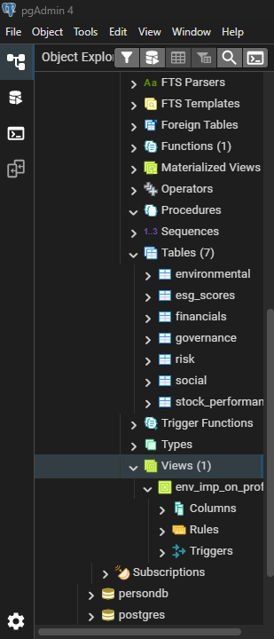
Data Points Stored
company ESG scores
financial performance metrics
stock market performance
environmental impact metrics
social responsibility indicators
governance metrics
external risk and controversy scores.

Slide 4
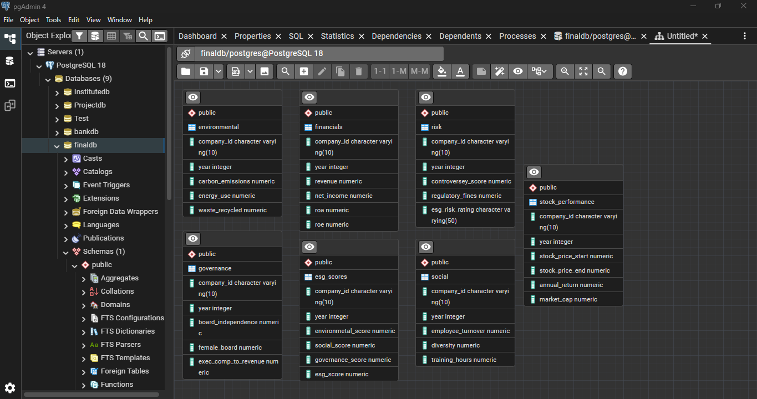
ERD Diagram

Slide 5
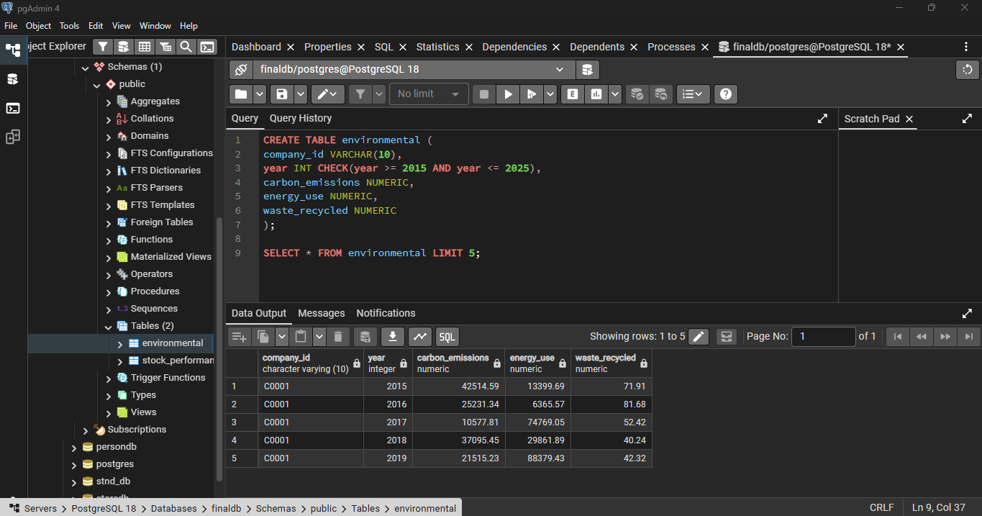
Data Types & Constraints
Data Types:
VARCHAR
INT
NUMERIC
Data Constraints:
CHECK to keep years in a specific range

Slide 6
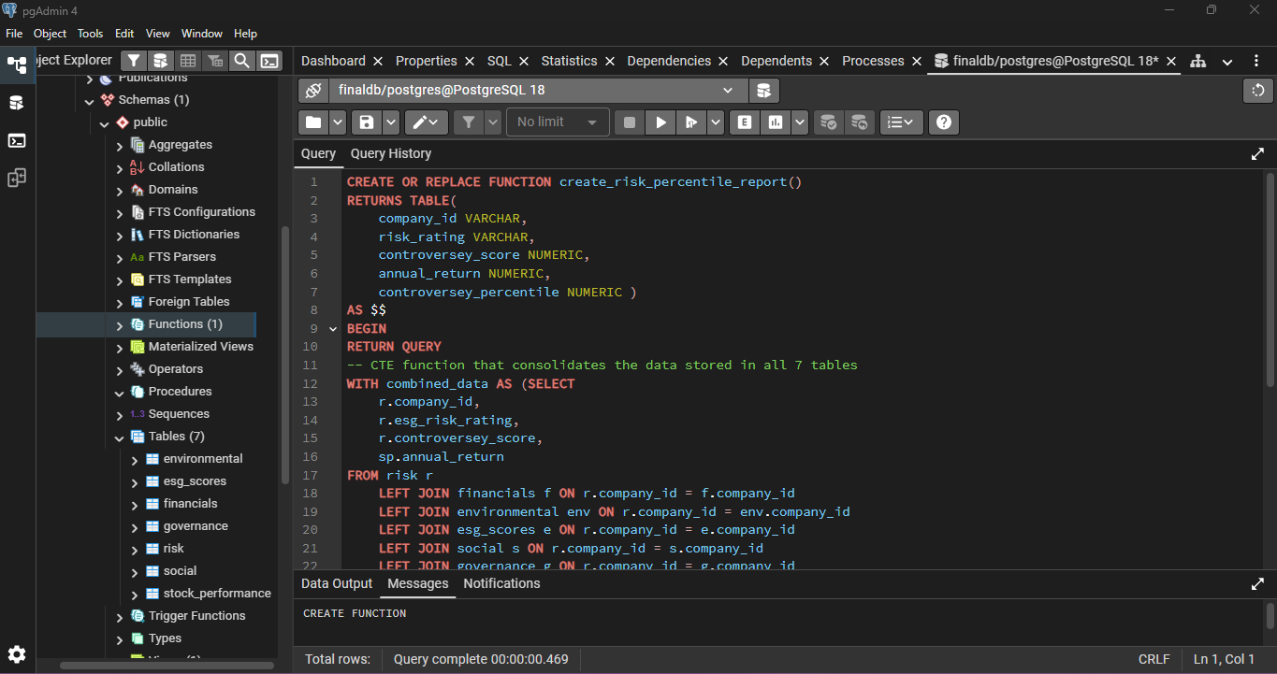
New Features
Advanced function that returns data in a new table that uses all 7 tables that were created. It combines WINDOW and CTE Functions.

Slide 7

Any Questions?

